Slide 1
GAR
Session 09: Geometry Wars

Slide 2
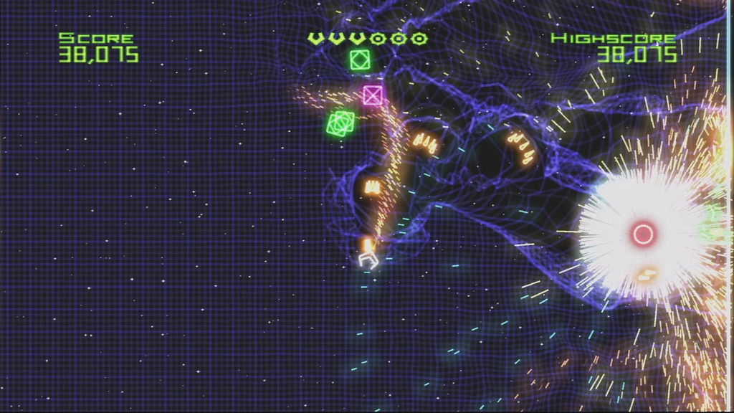
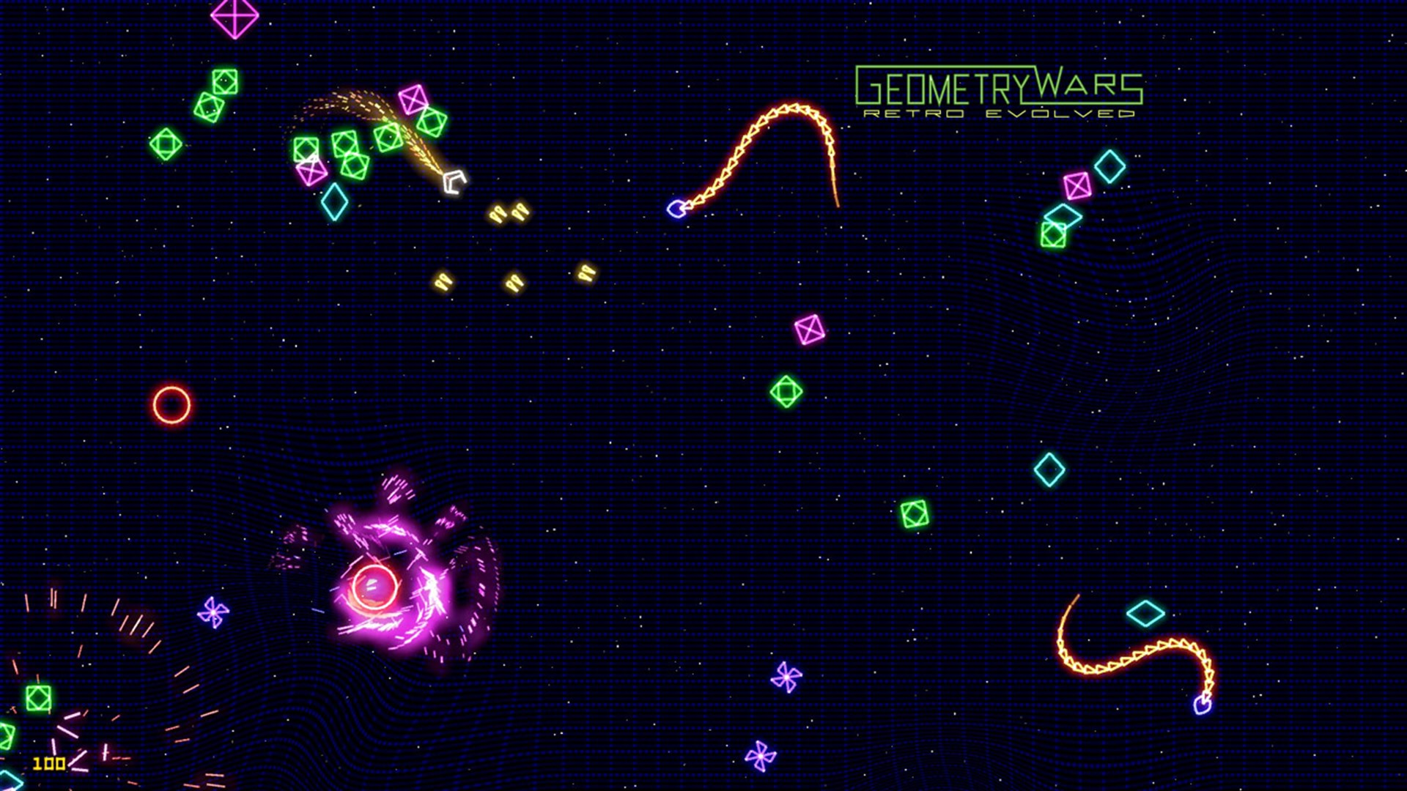
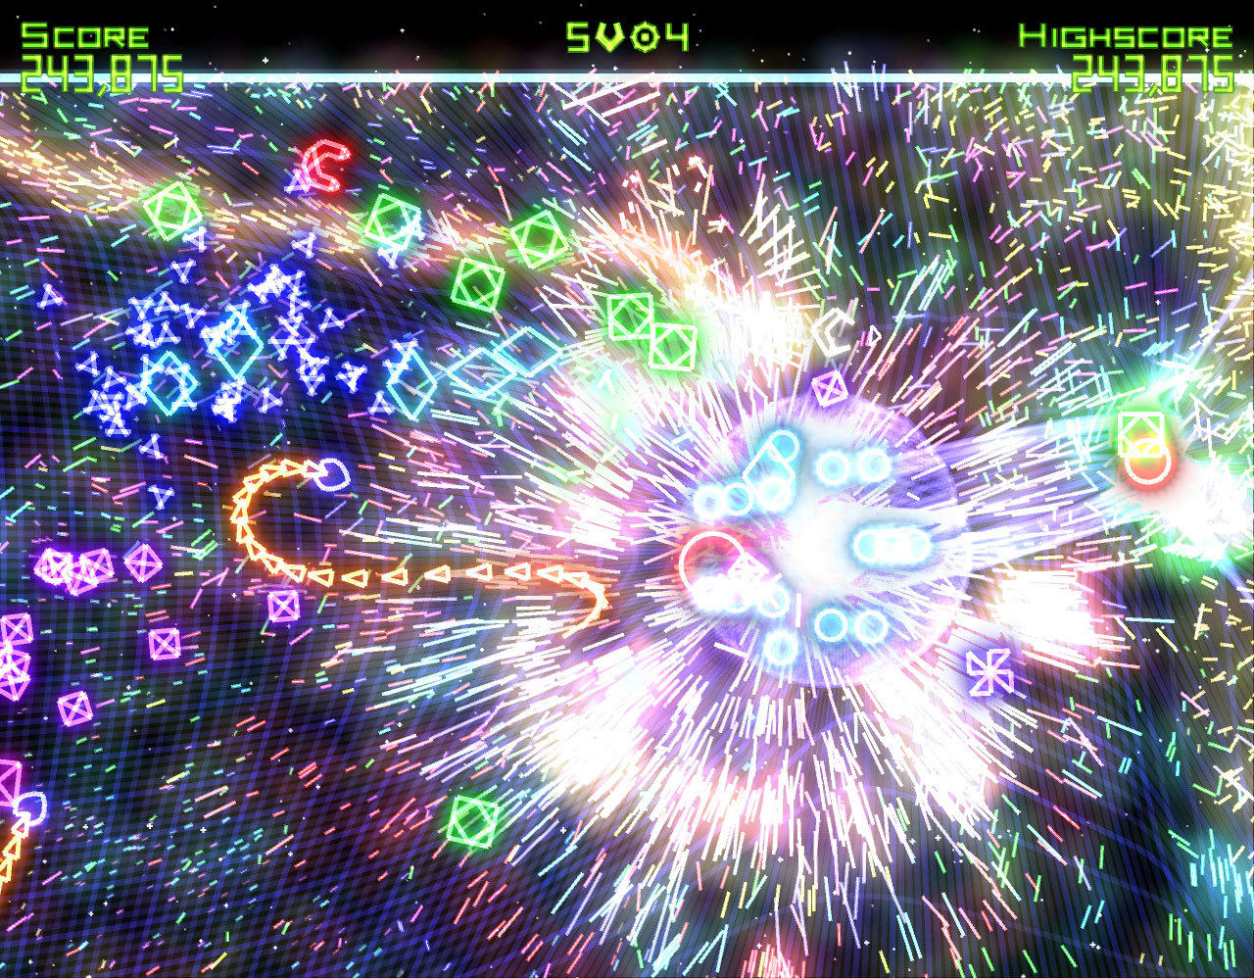

Geometry Wars

Slide 3
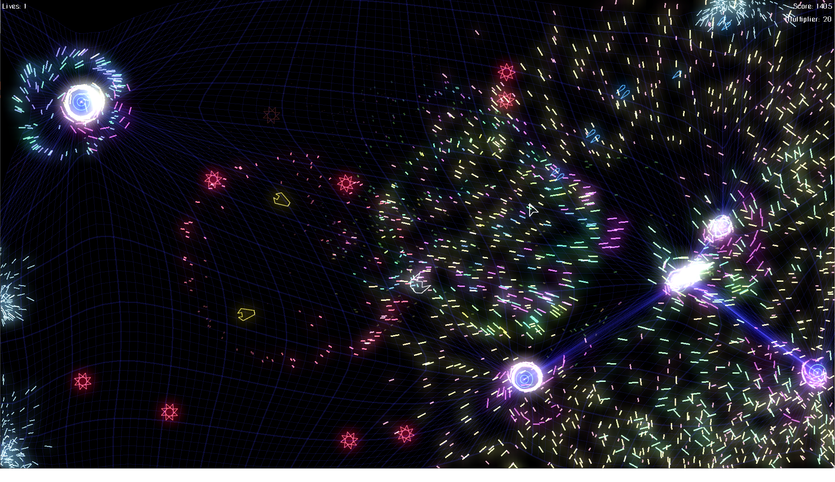
Today’s Goal

Slide 4
Today’s Topics
Component Pattern
Data Oriented Design
Object Pool Pattern
Flyweight Pattern
Shaders

Slide 5
Why Geometry Wars?
Thousands of entities on screen at 60 FPS
Naive OOP collapses: deep inheritance, GC churn, cache misses
Forces real architectural decisions
  Every pattern today fixes a real bottleneck
The iconic neon glow and grid warp are pure shader work

Slide 6
Source Code
All Source code for today’s game can be found here:
  https://github.com/Metamate/gmd2-geometrywars
Walkthrough in README.md
The goal is not to understand all the systems, but the overall architecture employed
The game is built up in steps: GeometryWars0 → GeometryWars6
  Each step adds components to the entity recipes, and the systems they need
  Compare neighbouring steps to see exactly what changed
GeometryWars6 is the finished game: explore it, and start the exercises from it

Slide 7
Steps
GeometryWars0: entities & components, the player ship
GeometryWars1: shooting & Object Pool
GeometryWars2: enemies, collisions, score and lives
GeometryWars3: particles
GeometryWars4: the spring grid and black holes
GeometryWars5: bloom
GeometryWars6: audio (the finished game)

Slide 8
Explore the Codebase
Take ~10 minutes to browse the finished game, GeometryWars6. Use the README as a guide if you need it.
Clone the repository and build and play the game
  How high a score can you get? ;)
How is the codebase split between the core library and the geometry wars-specific project?

Slide 9
High-Level Architecture
Game1 owns the application shell
PlayState owns one active gameplay state
PlaySession owns one run of the game
EntityWorld updates entities and collisions
EntityFactory builds entities by composing components
Components implement the actual behavior
Systems handle some cross-component concerns
Game1 → PlayState → PlaySession → EntityWorld / EntityFactory → Components

Slide 10
Component Pattern - The Problem
Inheritance seems natural: Enemy → ShootingEnemy → HomingShootingEnemy…
But every new behavior combination doubles the hierarchy
Want a homing enemy that also explodes? Copy-paste the homing code
The diamond problem, fragile base classes, and dead code everywhere
Behavior should be composed, not inherited

Slide 11
Component Pattern - The Solution
An Entity is just an ID plus a bag of components
Components hold data and a small slice of behavior
Transform, Sprite, Collider, Health, AIController, Weapon…
Mix and match: a HomingExplodingEnemy is just Homing + Explode components
Systems iterate over entities that have the components they care about
Favor composition over inheritance
  The classic OOP maxim, made concrete
Components are reusable
  If you keep the “Single Responsibility Principle” in mind

Slide 12
Component Pattern - Simple Example
public class Entity {
public int Id;
public List<Component> Components = [];
}
public abstract class Component { public Entity Owner; }
public class Transform : Component { public Vector2 Position; public float Rotation, Scale; }
public class Sprite : Component { public Texture2D Texture; public Color Tint; }
public class Health : Component { public int HP; }
// Spawn a grunt enemy: no new class needed
var grunt = new Entity();
grunt.Components.Add(new Transform { Position = spawnPoint });
grunt.Components.Add(new Sprite { Texture = gruntTex });
grunt.Components.Add(new Health { HP = 1 });

Slide 13
Component Pattern Implementation
Component.cs
Entity.cs
EntityFactory.cs
Steps: GeometryWars0 onwards; every step adds components

Slide 14
Data Oriented Design
Think in Data, Not Objects
OOP asks: "What is a bullet?" — DOD asks: "How does bullet data flow?"
Array of Structs (AoS)
  Bullet[] — each bullet is one object with all its fields
Struct of Arrays (SoA)
  Separate float[] positionsX, positionsY, velocitiesX, …
SoA packs the fields you actually touch tightly together in memory
Update loop reads only what it needs
  Nothing else is dragged into cache
Notes:
Not the same as Data-Driven Design!

Slide 15
Memory Layout Matters
L1 cache hit: ~1 ns
  Main memory miss: ~100 ns — a 100× penalty
A CPU fetches 64 bytes at a time (one cache line)
  Make them count
AoS Bullet { Pos, Vel, Sprite, Owner, Tag, … } ≈ 80 bytes per object
Updating positions drags sprites, tags, and pointers through cache too
SoA positions[]: 16 bullets fit in one cache line
  16× the throughput
Thousands of bullets flying? This is the difference between 60 FPS and 15

Slide 16
SoA Example
public class BulletSystem {
const int MAX = 10_000;
public Vector2[] Position = new Vector2[MAX];
public Vector2[] Velocity = new Vector2[MAX];
public float[] Lifetime = new float[MAX];
public bool[] Active = new bool[MAX];
int count;
public void Update(float dt) {
for (int i = 0; i < count; i++) {
if (!Active[i]) continue;
Position[i] += Velocity[i] * dt;
Lifetime[i] -= dt;
if (Lifetime[i] <= 0) Active[i] = false;
}
}
}
Notes:
Tight loop, linear memory access, branch predictor is happy.

Slide 17
SoA Implementations
Grid.cs
ParticleManager.cs
Steps: GeometryWars3 (particles) and GeometryWars4 (grid)

Slide 18
Object Pool - The Problem
You fire 20 bullets per second.
  Each hit spawns 30 particles.
  Each enemy dies into 50 debris pieces
That's thousands of new allocations per second
  All short-lived
C# is a managed language: new means the GC will eventually clean up
GC pauses are non-deterministic
A stutter every few seconds is the telltale sign of allocation-in-the-hot-loop

Slide 19
Object Pool - Simple Example
public class ParticlePool {
Particle[] items = new Particle[5000];
public ParticlePool() {
for (int i = 0; i < items.Length; i++) items[i] = new Particle();
}
public Particle Spawn(Vector2 pos) {
for (int i = 0; i < items.Length; i++) {
if (!items[i].Active) {
items[i].Reset(pos);
items[i].Active = true;
return items[i];
}
}
return null; // pool exhausted — size it generously
}
}
Notes:
pre-allocate MAX particles once, at load time.
Never `new` a Particle again for the rest of the game.
Release is just: p.Active = false; Zero GC pressure.

Slide 20
Object Pool Implementation
ObjectPool.cs
BulletSpawner.cs
Step: GeometryWars1

Slide 21
Flyweight Pattern
Share What's Shared, Store What's Unique
500 enemies on screen
  But they're all the same sprite
Intrinsic state: shared, immutable
  The Texture2D, the mesh, the stats template
Extrinsic state: per-instance
  Position, velocity, current HP, color tint
One EnemyType object holds intrinsic data
  Each Entity references it
500 entities × 4-byte pointer to one texture, not 500 copies of the texture
Memory: kilobytes instead of megabytes. Load time: instant instead of slow

Slide 22
Flyweight Example
// Intrinsic (shared) — one instance, referenced everywhere
public class EnemyType {
public Texture2D Texture;
public float MaxSpeed, SpawnHP;
public int ScoreValue;
}
// Extrinsic (per-instance) — one per live enemy
public struct EnemyInstance {
public EnemyType Type; // pointer — the flyweight
public Vector2 Position, Velocity;
public int CurrentHP;
}
// Draw: SpriteBatch batches draws of the same texture automatically
foreach (var e in enemies)
spriteBatch.Draw(e.Type.Texture, e.Position, Color.White);
Notes:
SpriteBatch itself is a flyweight: one GPU state change per texture, hundreds of sprites drawn in a single call.

Slide 23
Flyweight Implementations
GameAssets.cs
GameplayDefinitions.cs
Step: GeometryWars0 onwards

Slide 24
Shaders
Moving work to the GPU
CPU has ~8 cores. GPU has thousands
  But they all run the same program
Vertex shader: runs once per vertex
  Transforms positions, can displace geometry
Pixel (fragment) shader: runs once per pixel.
  Decides the final color
MonoGame ships with a default shader
  You can write custom ones in HLSL (.fx files)
Any per-pixel effect
  Glow, blur, distortion, color grading
The CPU submits draw calls; the GPU paints pixels in parallel

Slide 25
Bloom, The Signature Geometry Wars Glow
Bloom makes bright pixels bleed light into their neighbors
Render the scene to a RenderTarget2D instead of the back buffer
Threshold pass — keep only pixels brighter than some cutoff
Gaussian blur the bright pixels — horizontal pass, then vertical
Additively blend the blurred result back over the original scene
Each pass is a fullscreen quad with a different pixel shader (post-processing)

Slide 26
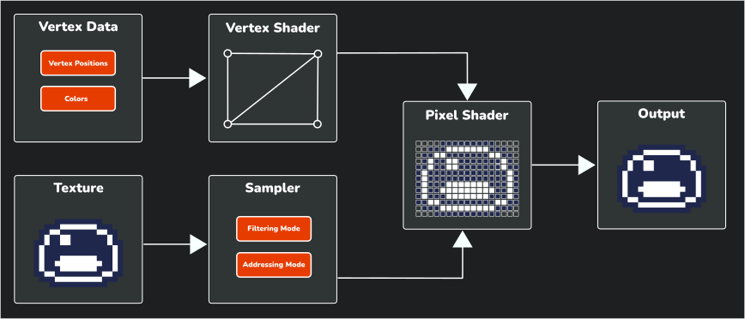
The Shader Pipeline
Notes:
Input Data: The process begins with input data that is sent to the GPU to render:
Vertex Data: The vertex data (positions, colors, etc.) that define the geometry of what is being drawn.
Texture: The image data that will be applied to the geometry.
Vertex Shader: Processes each vertex, calculating its final position on the screen and passing the data to the next stage.
Sampler: Controls how texture data is accessed, applying filtering (how pixels blend when scaled) and addressing (what happens at texture edges).
Pixel Shader: Takes the transformed vertices and sampled texture data to calculate the final color of each pixel.
Output: The final rendered image that appears on your screen.

Slide 27
Shader Implementation

Slide 28
Summary
Structure
  Component Pattern defines what an entity is
Memory Layout
  Data-Oriented Design defines how entities live in memory
Memory Allocation
  Object Pool decides when entities are allocated
Shared Memory (deduplication)
  Flyweight decides what entities share
Presentation
  Shaders decide how entities look

